Slide 1
CNN with YOUR DATA!

Slide 2
CNN with your data

Slide 3
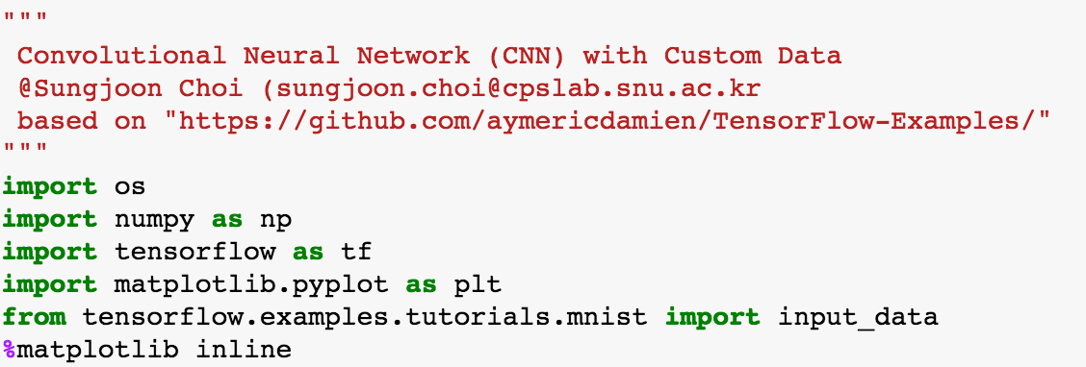
Import packages

Slide 4
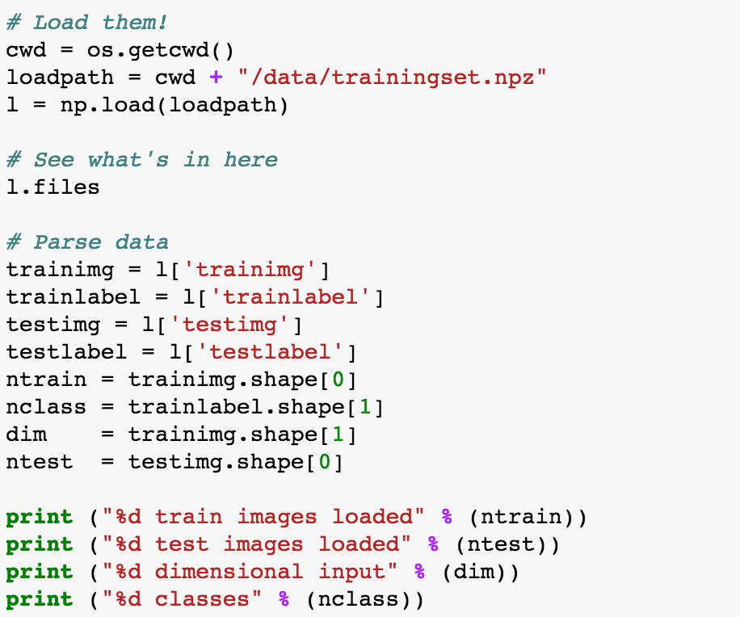
Load the data

Slide 5
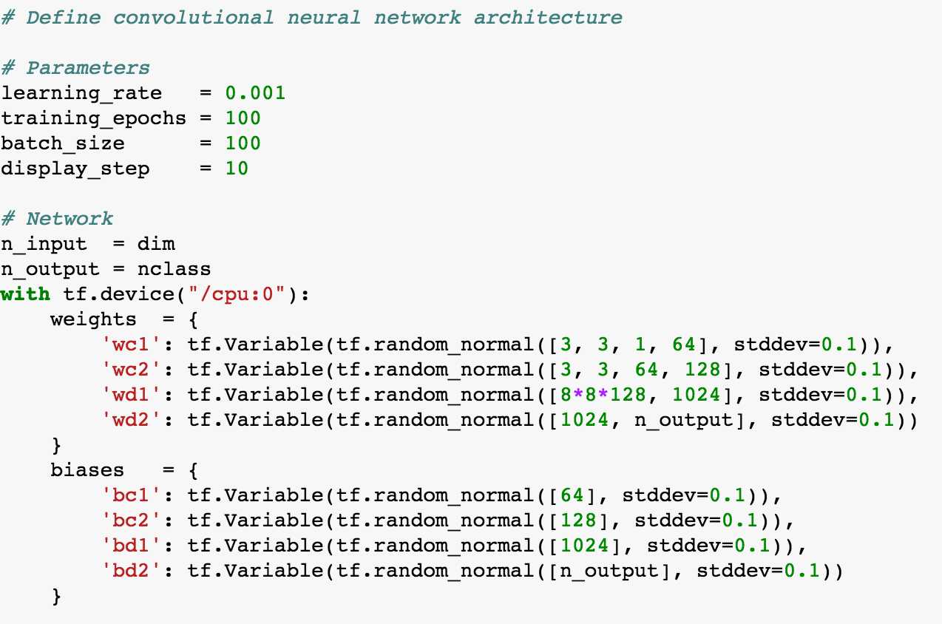
Define the CNN 1/3

Slide 6
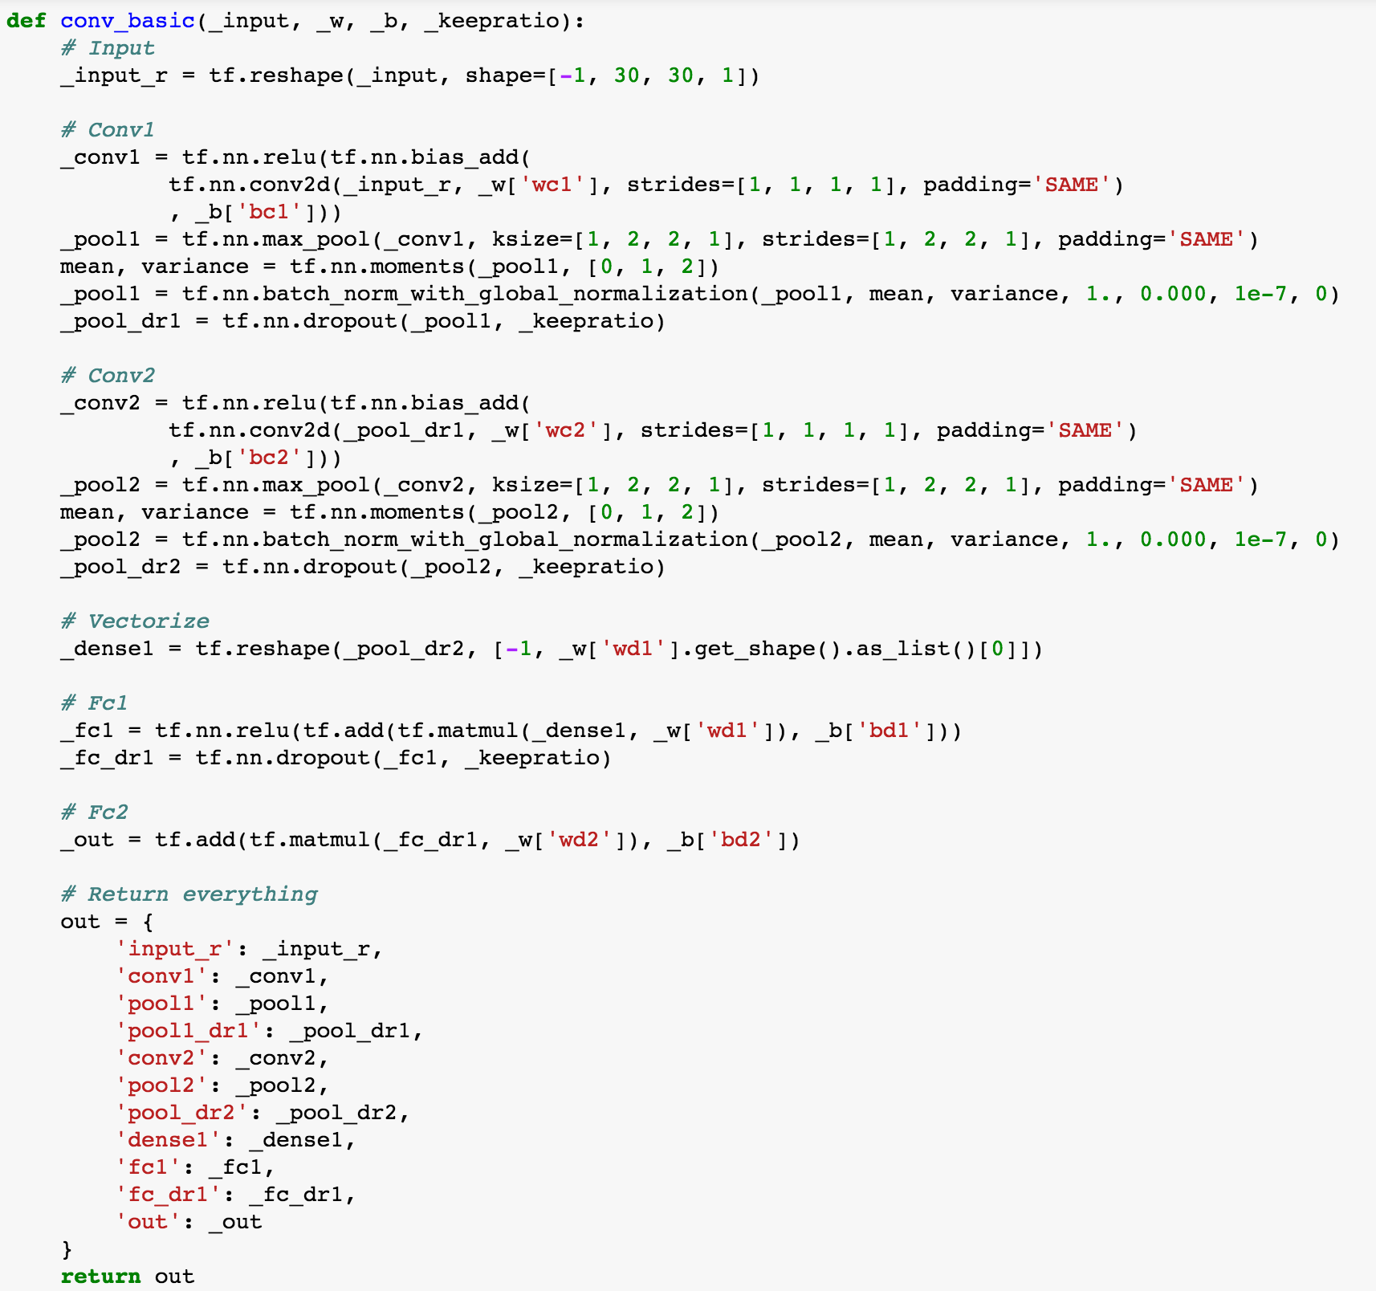
Define the CNN 2/3

Slide 7
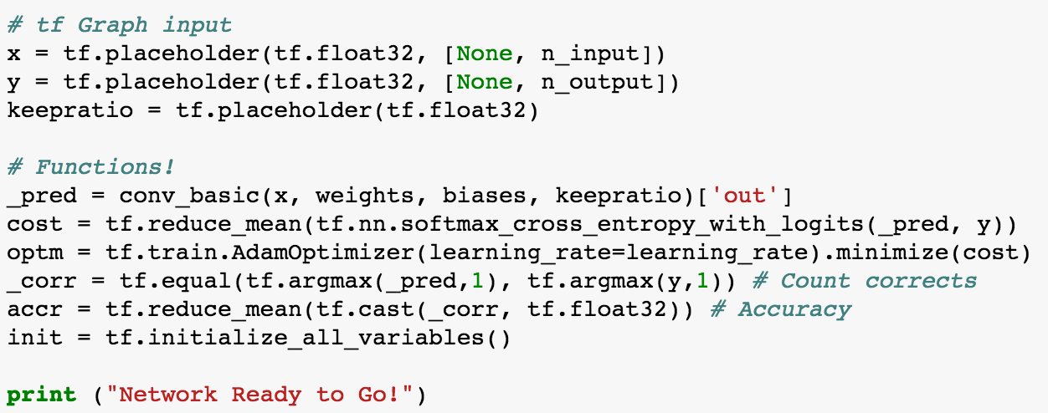
Define the CNN 3/3

Slide 8
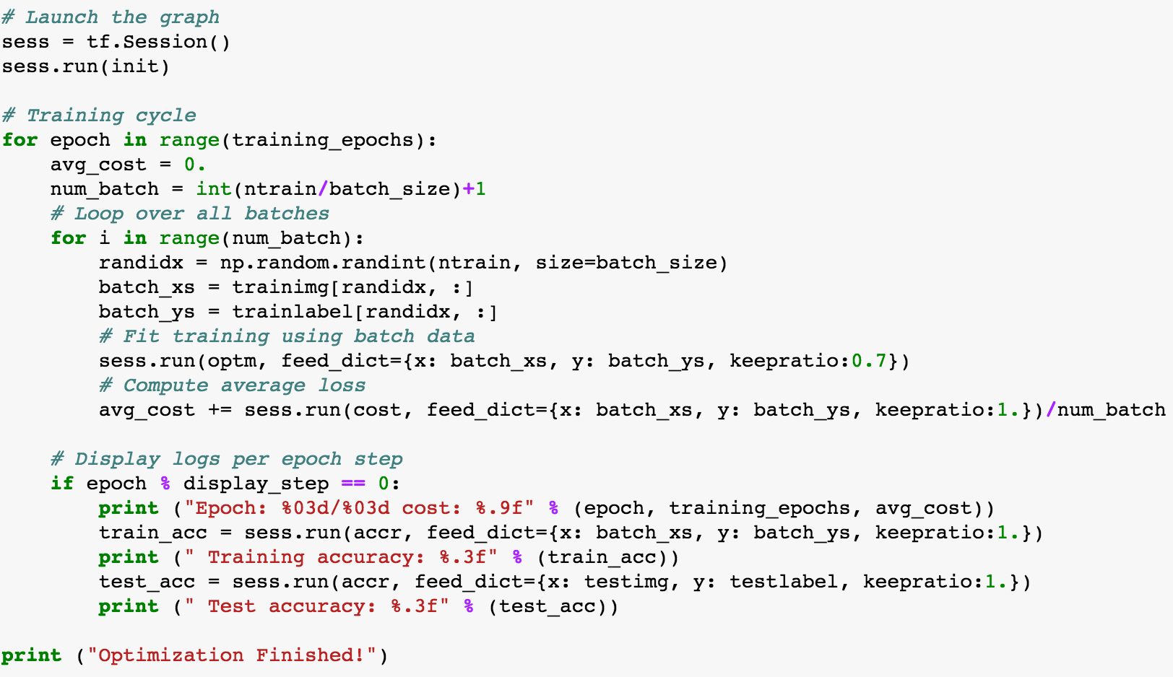
RUN!

Slide 9
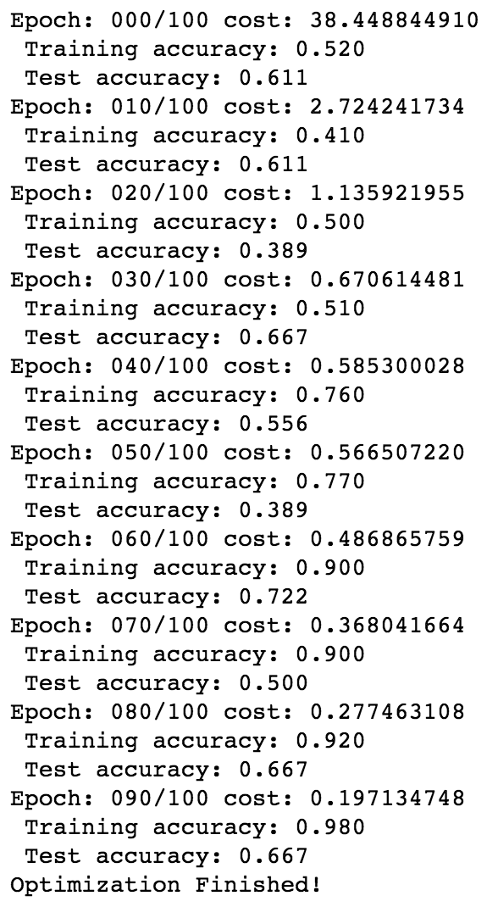
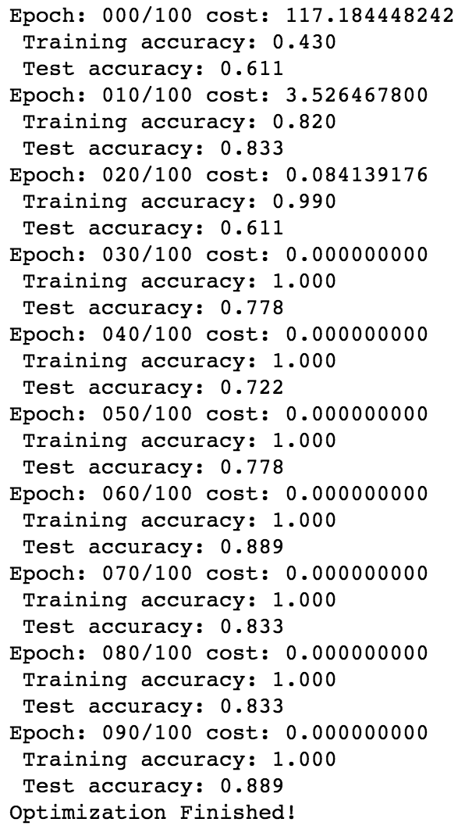
Results
Without BN
With BN

